Slide 1
Titanic Dataset

Slide 2
Data Analysis
Target: Goal is to identify the chance of survival for a titanic passenger.

Slide 3
Feature Description
Passenger ID: Id of passenger
Survived: Survival (0 = no; 1 = yes)
Pclass: Passenger class (1 = first; 2 = second; 3 = third)
Name: Name
Sex: Sex
Age: Age
SibSp: Number of siblings/spouses aboard
Parch: Number of parents/children aboard
Ticket: Ticket number
Fare: Passenger fare
Cabin: Cabin
Embarked: Port of embarkation (C = Cherbourg; Q = Queenstown; S = Southampton)

Slide 4
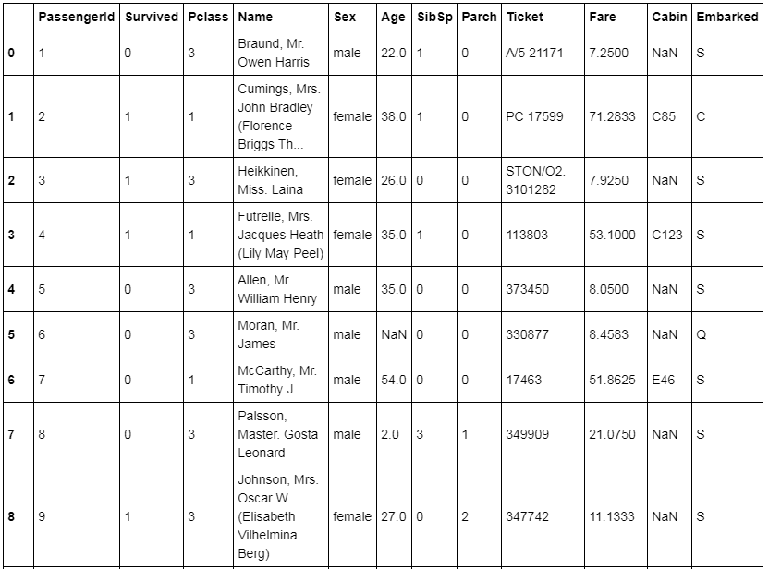

Slide 5


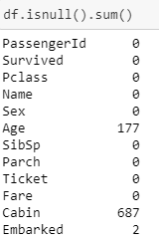
Data Analysis
Shape of dataset:
Survived count
Check for null values

Slide 6

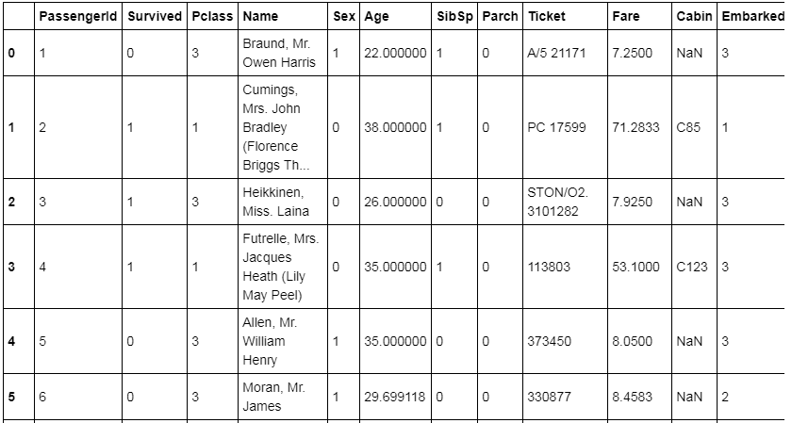
Replace or Remove the null values:
Column Encoding

Slide 7
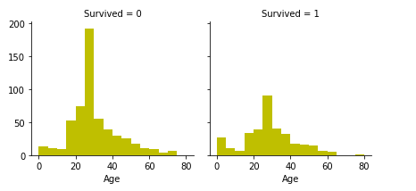
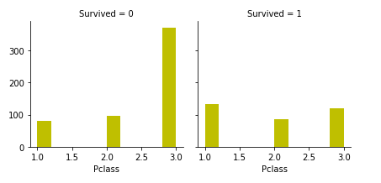
Visualization

Slide 8
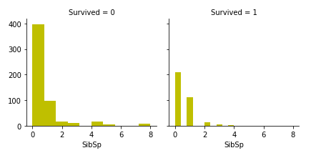
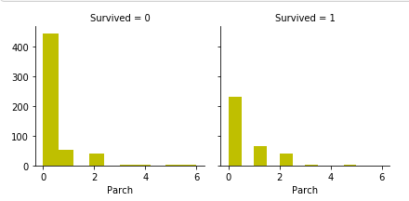

Slide 9
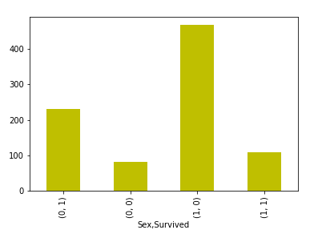
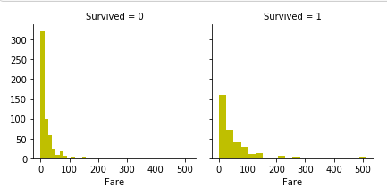

Slide 10
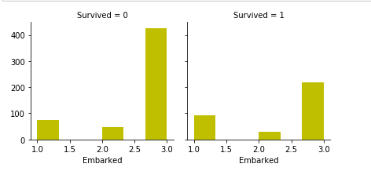

Slide 11
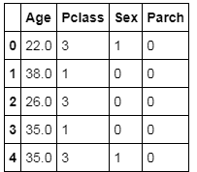
Feature Selection
Features Selected: Age, Pclass, Sex, Parch

Slide 12

Confusion Matrix

Slide 13
Accuracy Metrics
Accuracy: 0.77
Precision: 0.76
Recall: 0.65
Sepcificity: 0.86
F1 Score 0.7

Slide 14
Thank You

